Slide 1
Fagligt samspil

Slide 2
Vision/strategi
Informatik – et alment dannelsesfag
og en fundamental kompetence for alle
Tysk
...
Filosofi
Musik
Billedkunst
Informatik
Design
Geografi
Økonomi
Samfundsvidenskab
Engelsk
Psykologi
Geologi
Marketing
Spansk
Biologi
Literatur
Kemi
Historie
Fysik
Oldtidskundskab
Kinesisk
Bioteknologi
Sprog
Informatik
Matematik
Matematik er (primært) naturvidenskabernes sprog
Informatik er et sprog for alle fag og discipliner
Notes:
Informatik er ikke blot en sag for specialister.
Informatik, er et nyt dannelsesområde og en ny fundamental kompetence som alle i det 21. århundrede bør udstyres med fra barnsben – helt på linje med at kunne læse, skrive og regne. Intet mindre!

Slide 3
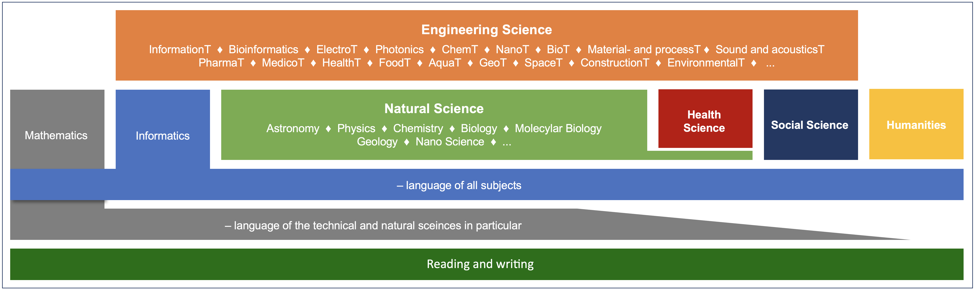
Foundations of competences Informatics – the new kid on the block
Informatics is the language and the science behind the digital revolution.
Informatics is becoming a language of all disciplines.
Informatics – a fundamental discipline for the 21st century.
Informatics is now playing the role, which mathematics did from the 17th through the 20th centuries: Providing an orderly, formal framework and exploratory apparatus for other sciences.
George Djorgovski (2005)
Notes:
This figure illustrates that in our increasingly digital society we now have an emerging fourth fundamental competence – informatics – to complement the three familiar fundamental competences of reading, writing and mathematics.
The figure also illustrates that informatics has a broad scope like reading and writing. In universities, we are currently witnessing how also the social sciences and the humanities embrace informatics and computational methods in research and education.
Informatics is indeed becoming a fundamental discipline for the 21st century.

Slide 4
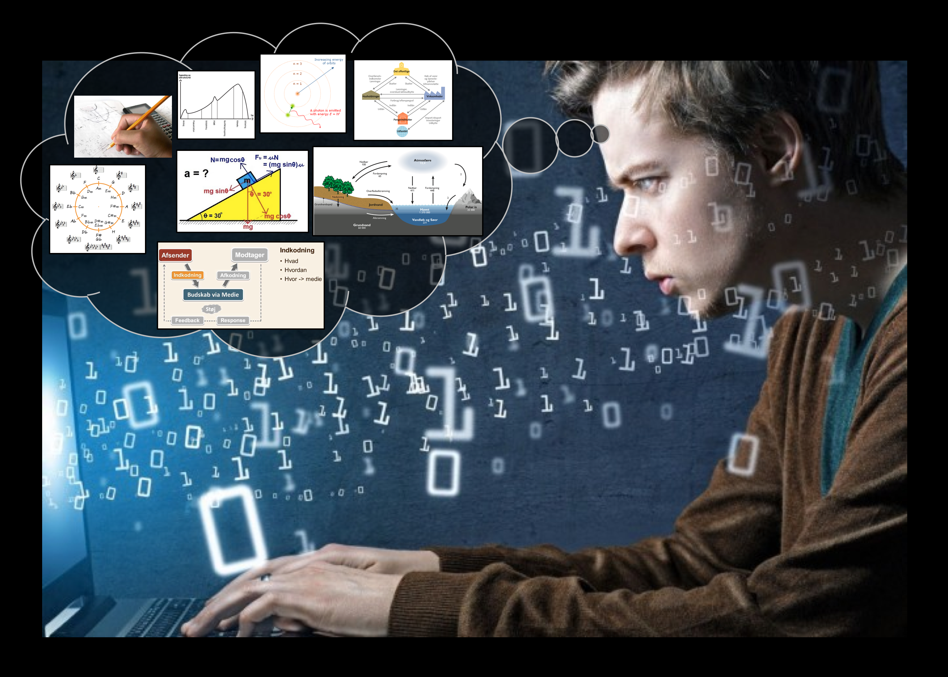
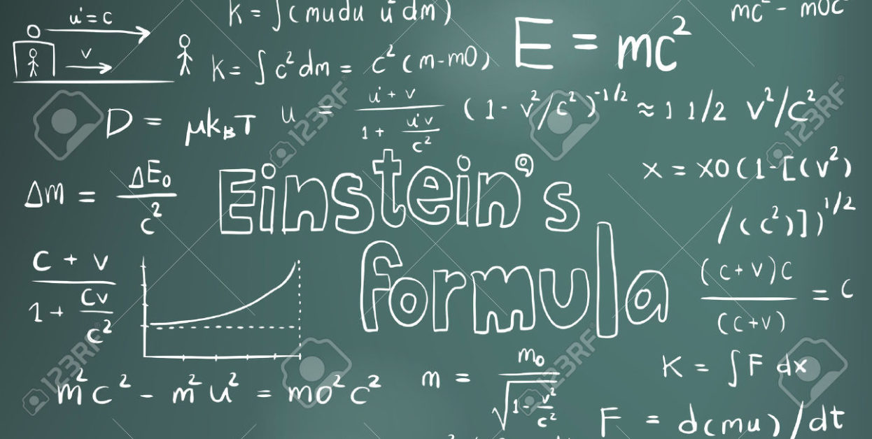
Informatik/CT – et nyt sprog
1. Talesprog
2. Skriftsprog
3. Matematisk sprog
4. Computationelt sprog
=
Det tog menneskeheden 150 år at blive enige om tegnet for lighed
(1557 - 1700)
Notes:
Informatics may be conceived as humankind's fourth major language alongside spoken language, written language and the language of mathematics.

Slide 5

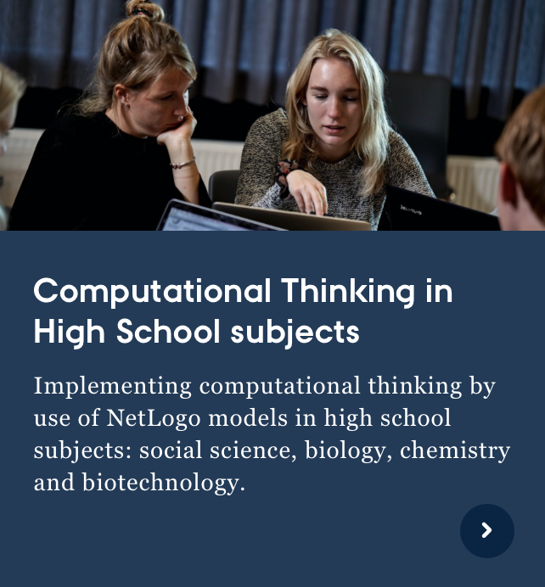
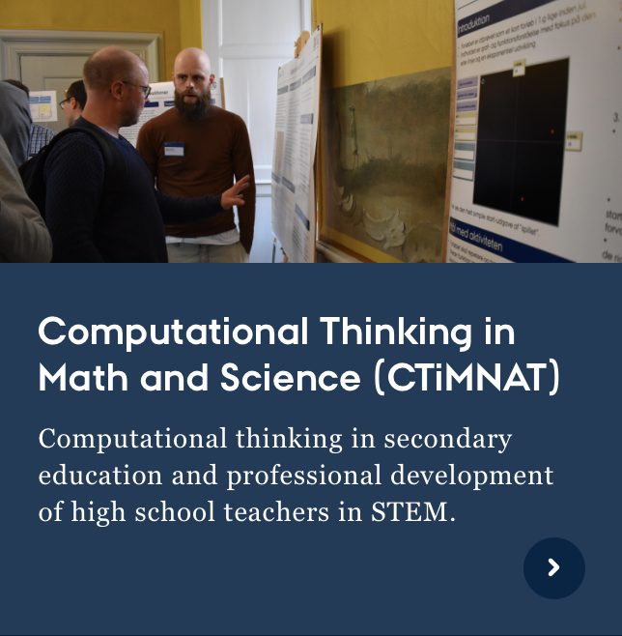
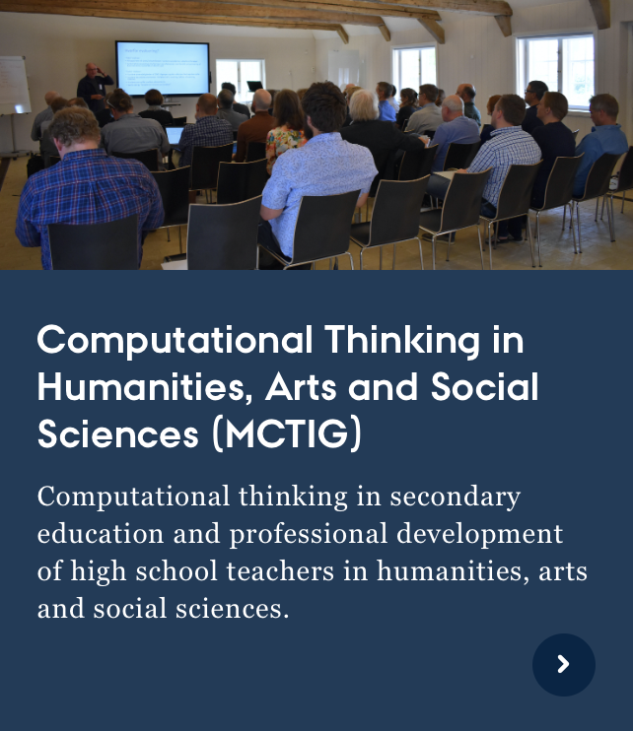
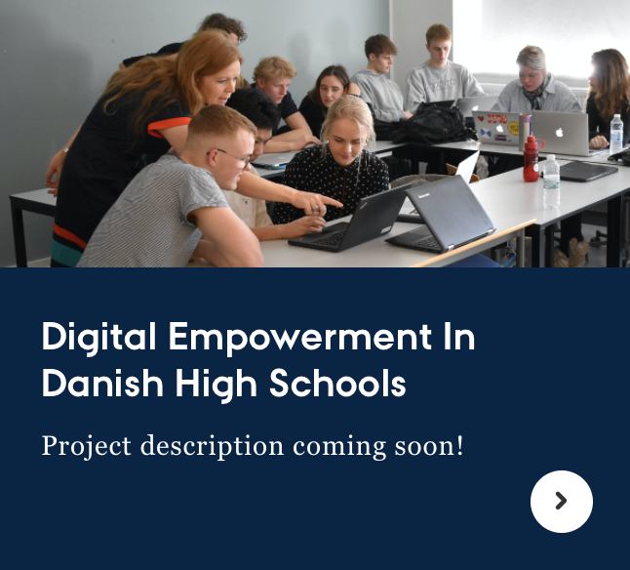
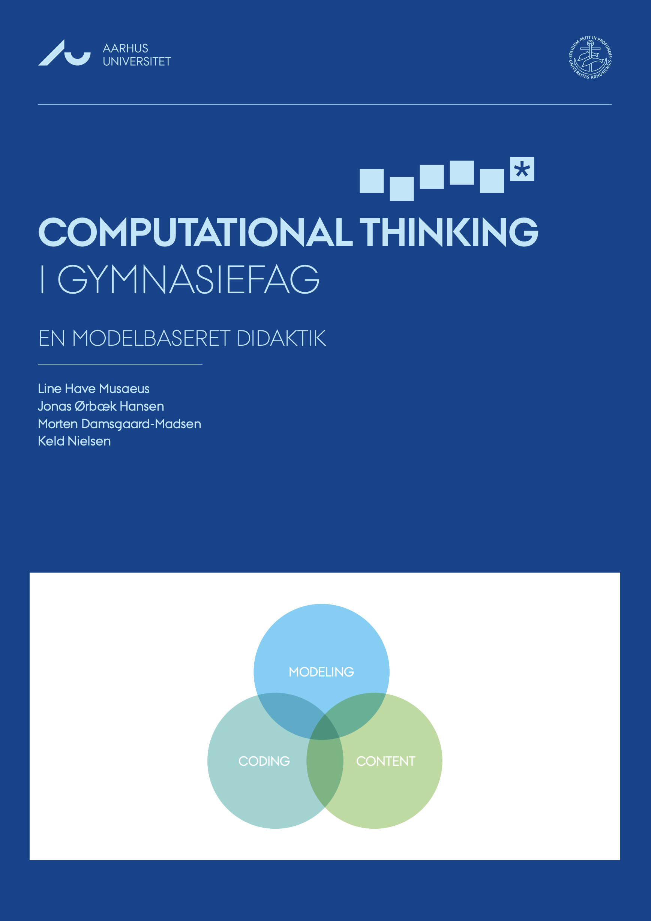
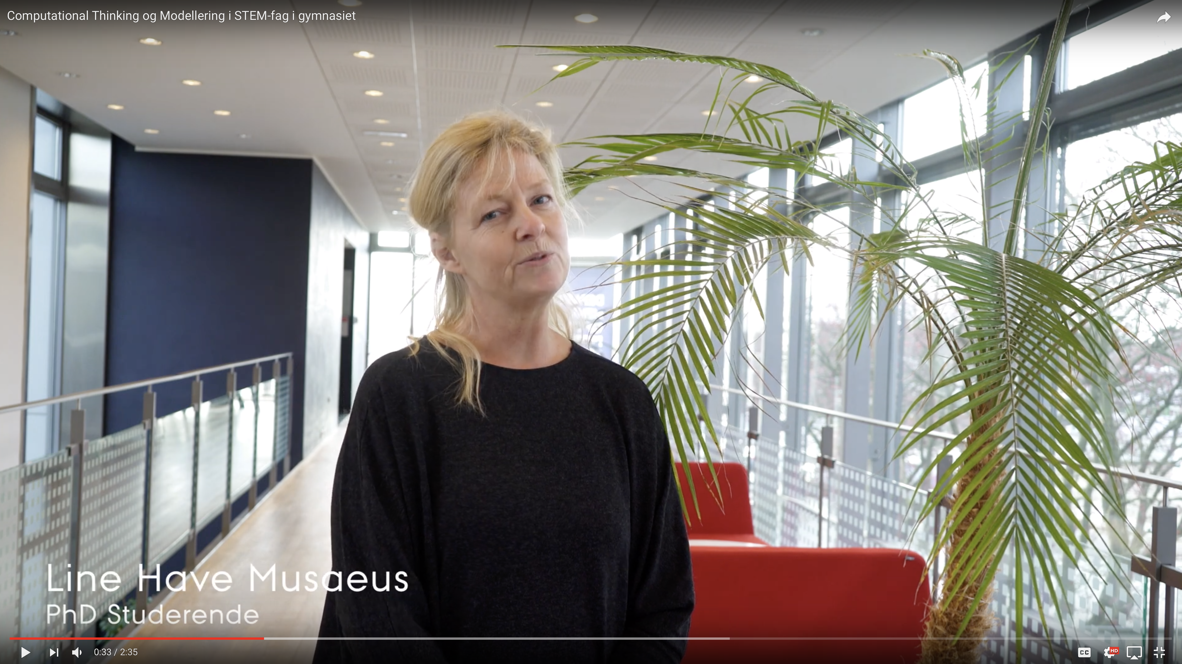
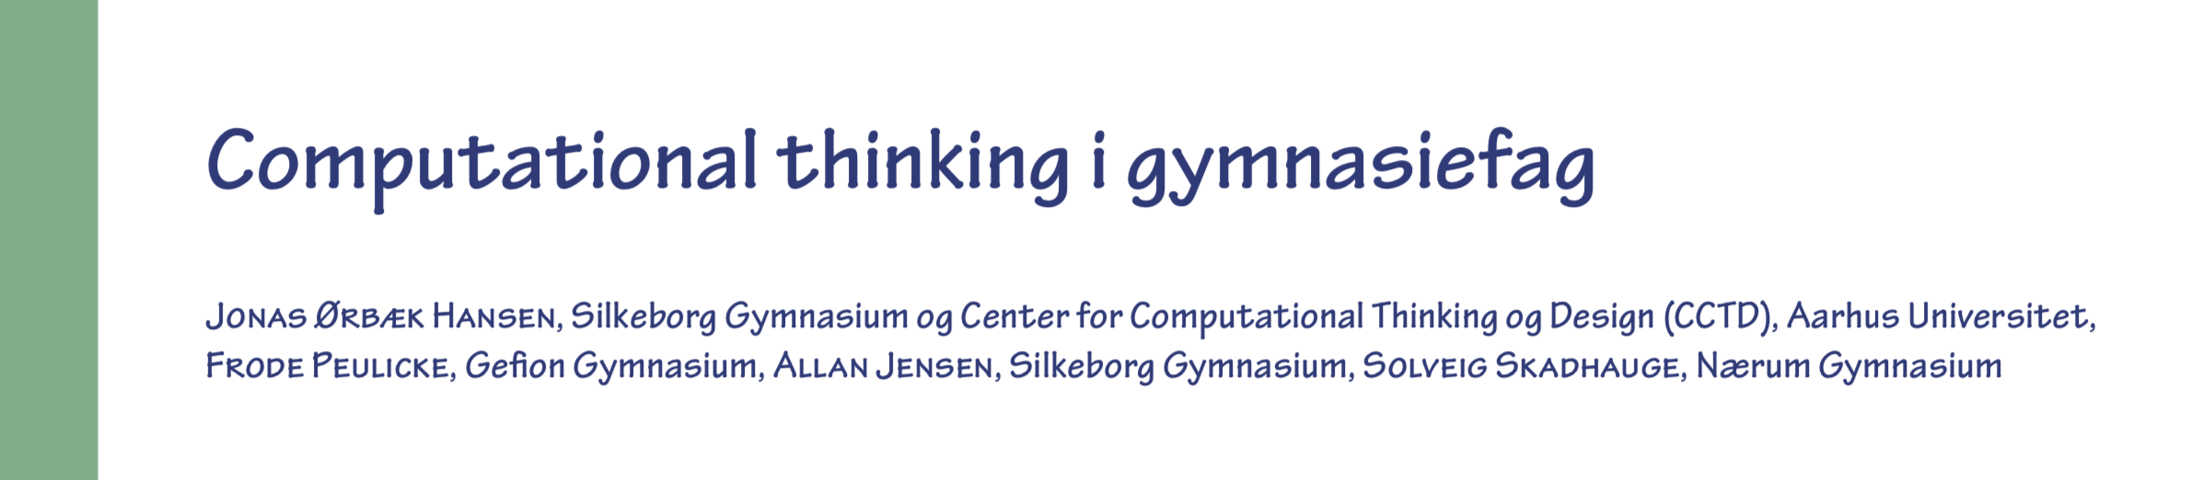
CT i gymnasiefag
2017
2018-2020
2018-2020
2019-2021
2020-2024
…
CT i gymnasiefag
Region Midtjylland
0,5 mio. kr.
CT i mat og nat
VILLUM FONDEN
3,15 mio. kr.
I alt 7,75 mio. kr.
CT i hum og samf
Midtjysk Teknologipagt
2,2 mio. kr.
CT i hum og samf
Midtjysk Teknologipagt
0,6 mio. kr.
Data expeditions @ KU
Novo Nordisk Fonden
6 mio. kr.
Læs om CTiMNAT i LMFK-bladet, februar 2020, i alt 21 sider

Slide 6
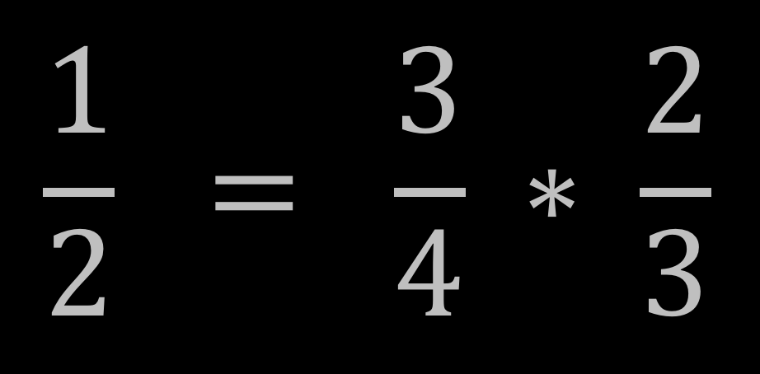
Naturligt vs. matematisk sprog
It is indeed
too odd
for words
that half's
three quarters
of two thirds.
- Piet Hein
Notes:
A new language evolves because it enables simple expression of otherwise complicated matters.
Here is an example of what mathematics enables to express in a simple way compared to written language – illustrated with a so-called Grook by Piet Hein.
It is indeed ...
This is almost impossible to parse and comprehend.
[Shift to 16a – animation]
... but if we express it mathematically, it is trivial to grasp the assertion and to verify its validity.

Slide 7
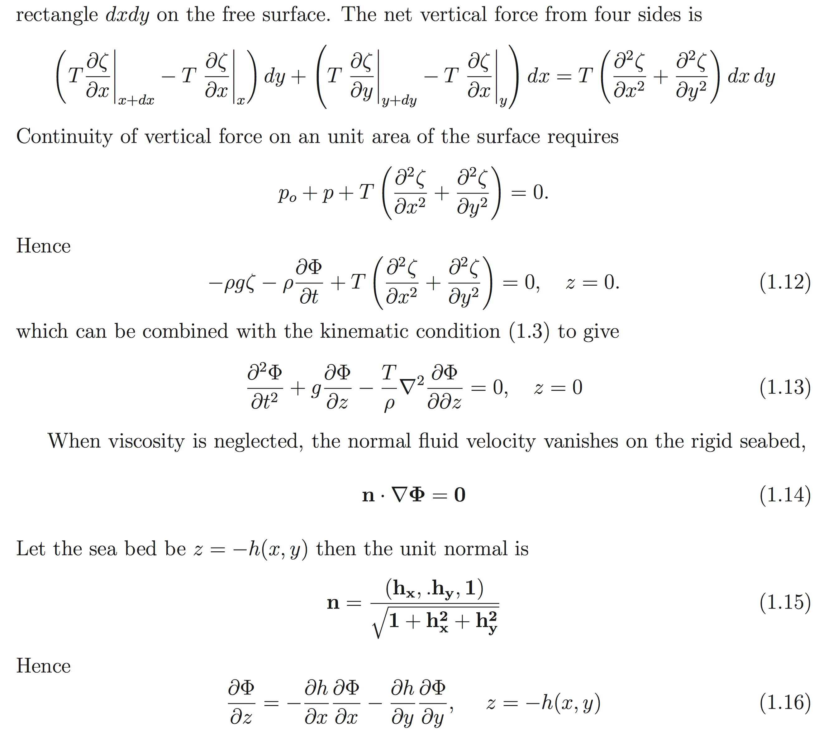
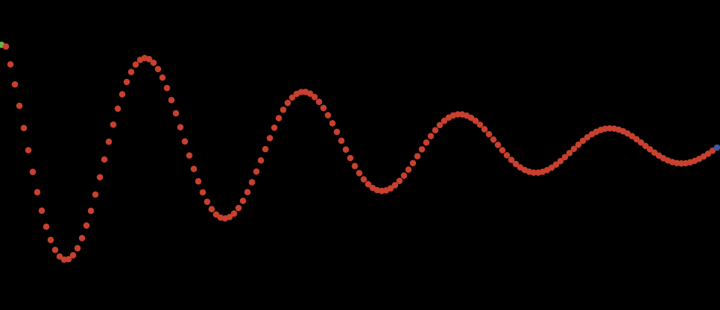
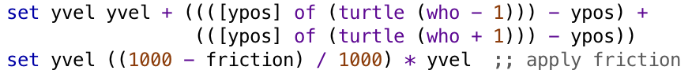
Matematisk vs. computationelt sprog (1)
Bølgemodel
Centralt
Stokastiske metoder, differentialligninger
og mange andre "gode" sager
40 sider ikke-triviel matematik
Decentralt
Simpel lokal regel: (a+b) / 2
Emergens og dynamik "foræret"
Agentbaseret modellering (ABM)
Notes:
A similar relation exists between mathematical and computational language.
Here illustrated by wave modelling.
The traditional approach to wave modelling requires very complicated mathematics in the form of coupled differential equations, and then almost all people are completely lost.
However, a simple computational model can be created, and all it takes – with respect to math – is very basic calculus, namely addition and division by 2.
A decentral agent-based approach to modelling enables creation of transparent computational models of complex dynamic systems which pupils from an early age can comprehend, investigate, modify and so forth.
In this way and in the concrete context of wave modelling, pupils can investigate and gain experience with advanced concepts such as frequency, amplitude, interference, plasticity, etc.

Slide 8
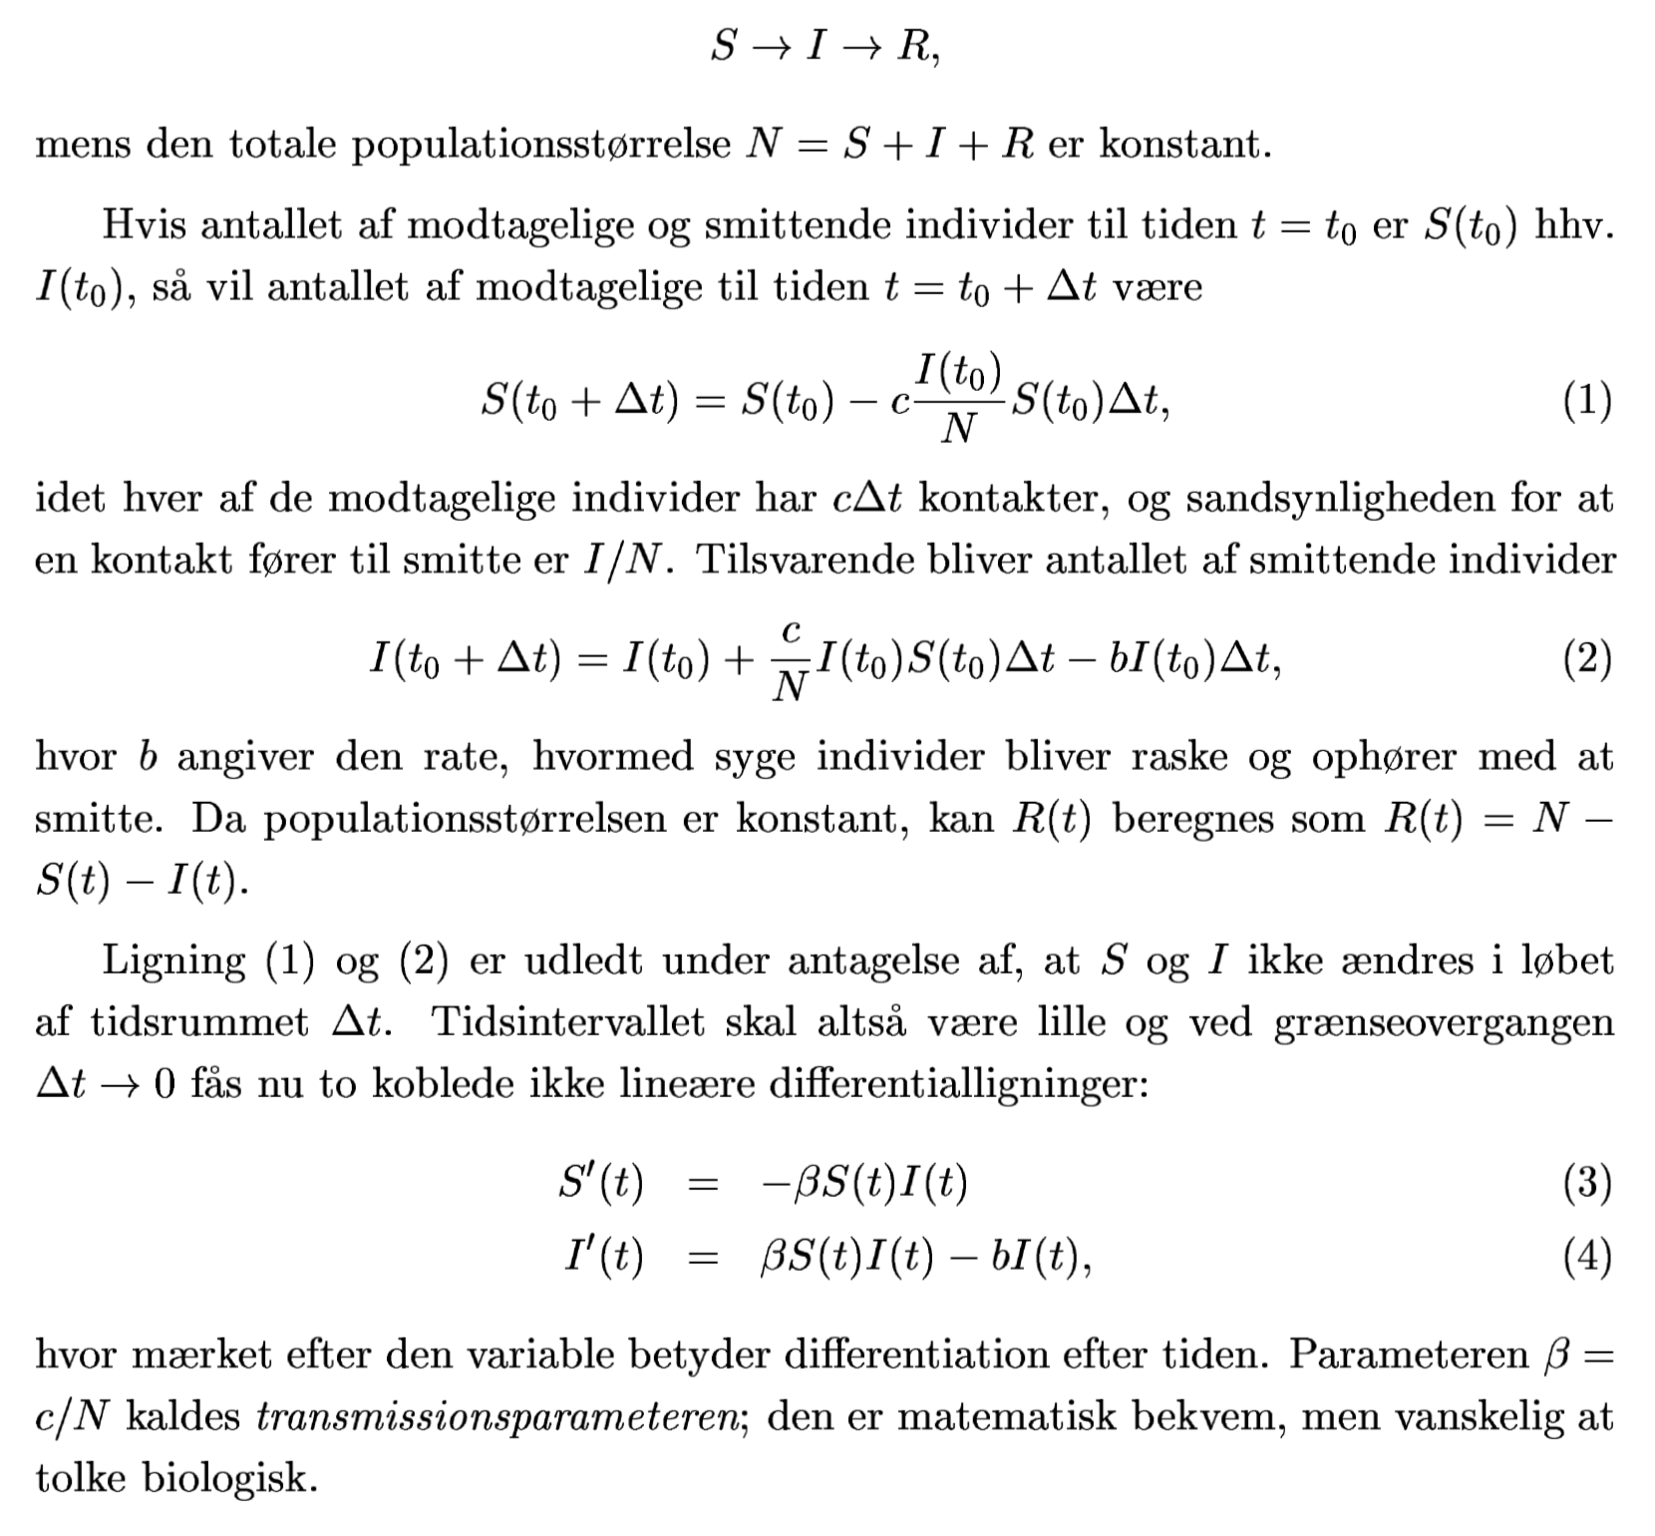

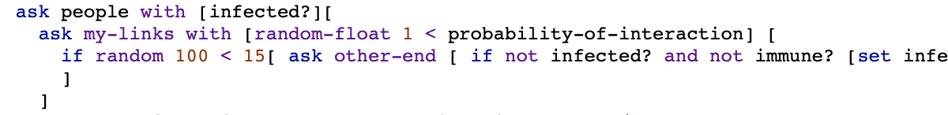
Matematisk vs. computationelt sprog (2)
Epidemimodel
March 14, 2020
Centralt
Stokastiske metoder, differentialligninger
og mange andre "gode" sager
25 sider ikke-triviel matematik
Decentralt
Simpel lokal regel
Emergens og dynamik "foræret"
Agentbaseret modellering (ABM)

Slide 9
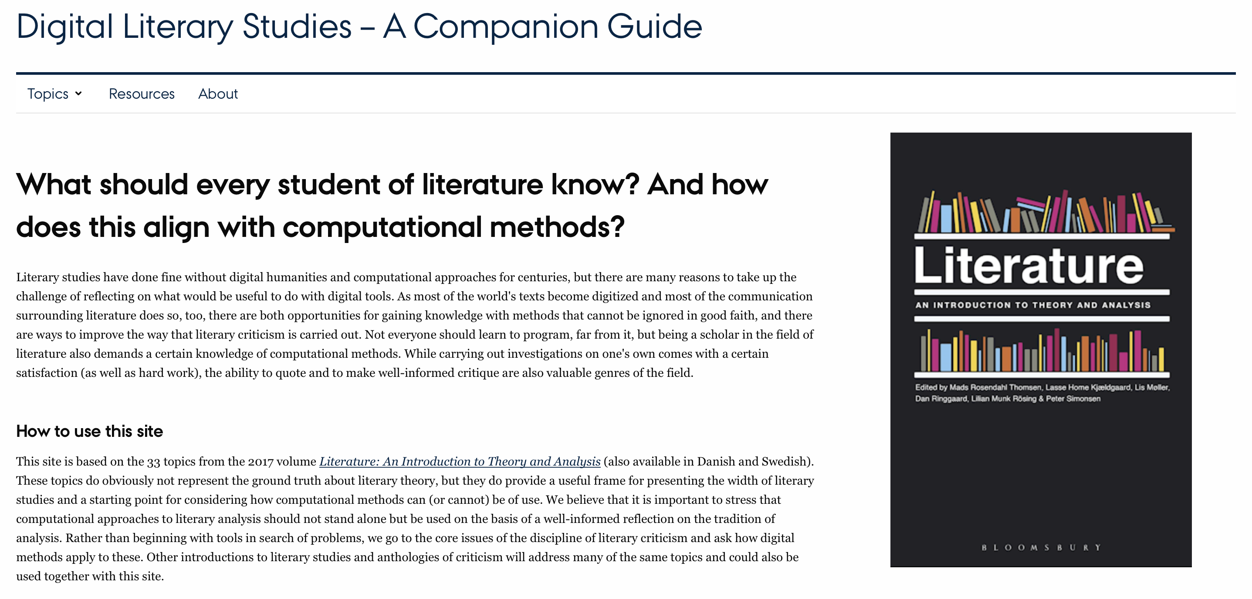
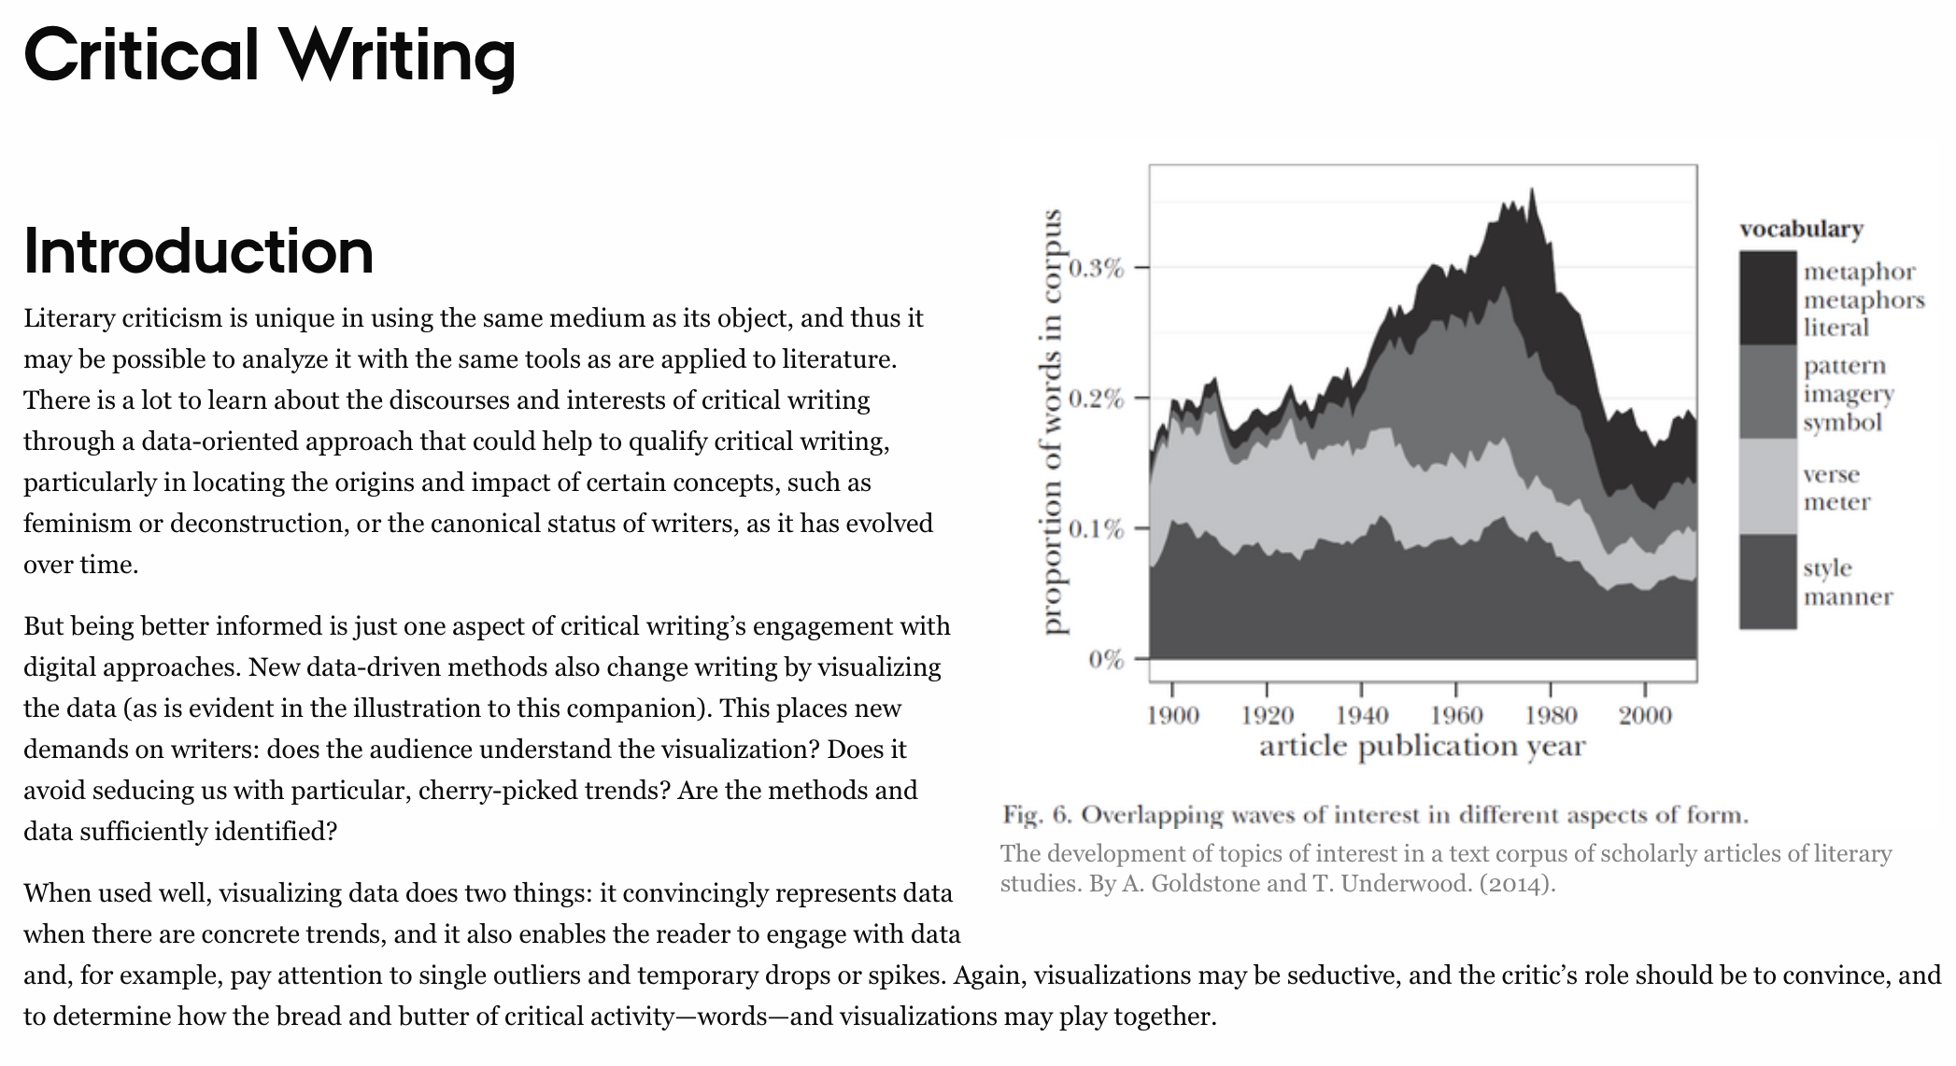
Nyt pilotprojekt om
Computationelle metoder i Dansk

Slide 10
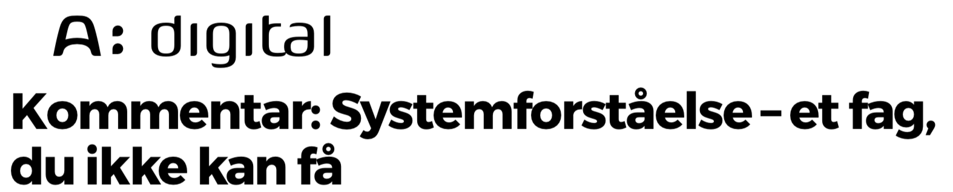
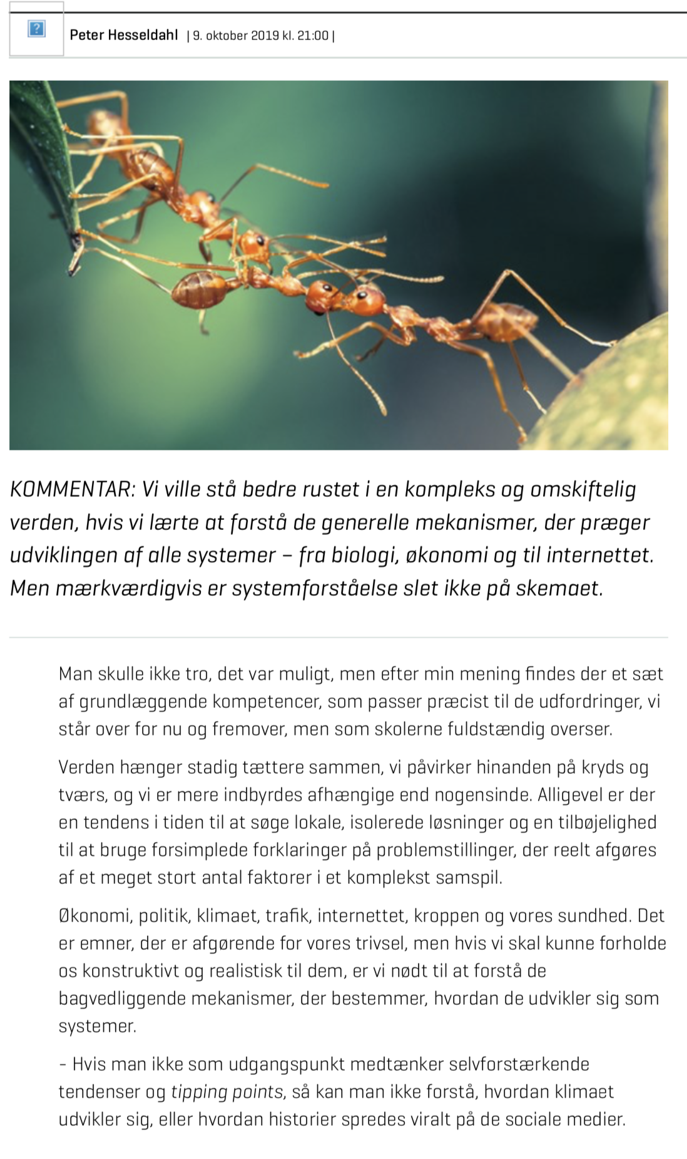
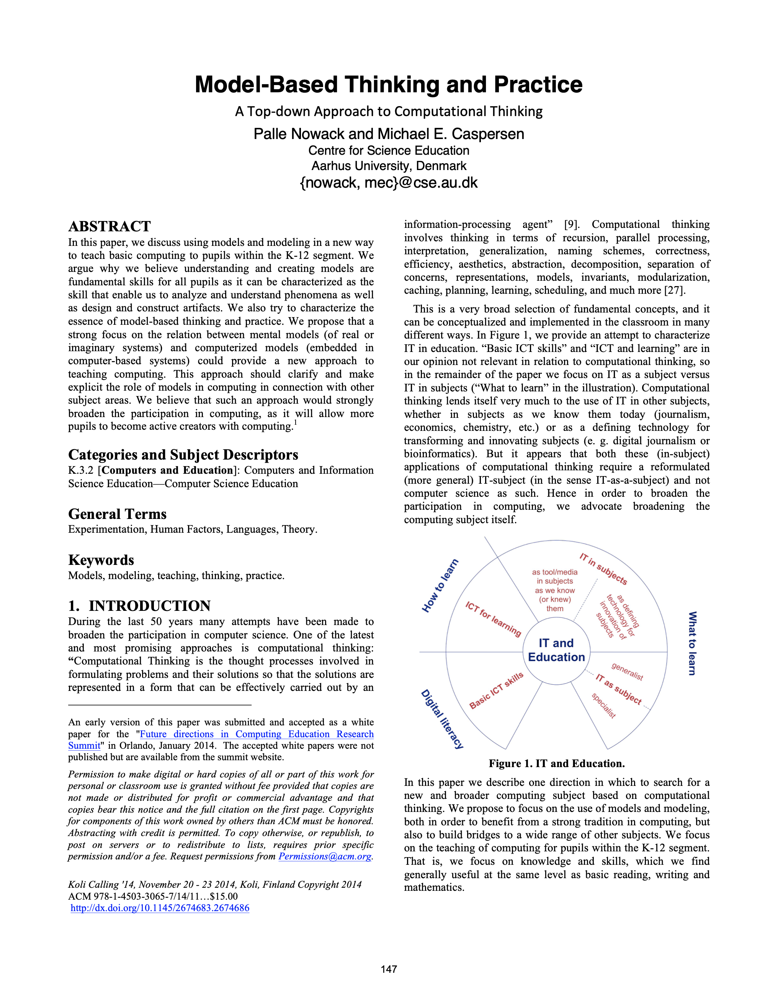
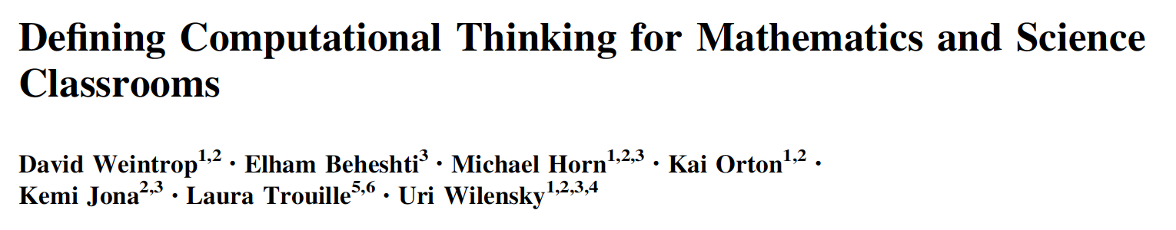
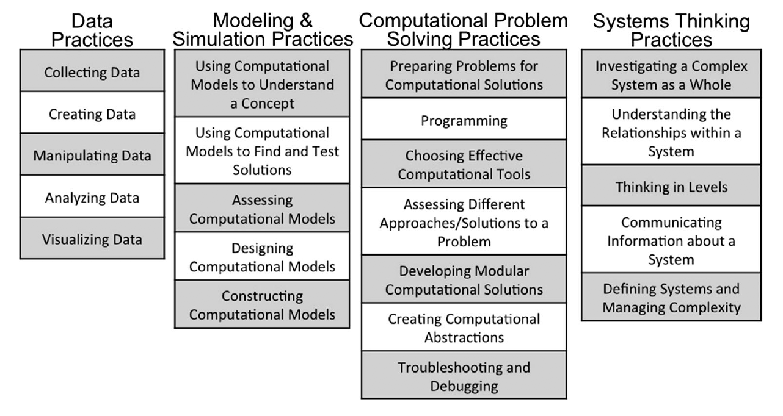
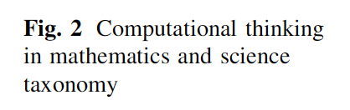
Skriftsprog og matematik
Statisk og deskriptivt (analogt)
Lukket (matematik) ...
Computationelt sprog
Dynamisk og generativt (digitalt)
Åbent...
Notes:
Computational language has evolved because it enables simple, generative description of processes – and because we have developed machines, that can execute such descriptions.
Thus, a computational literacy enables model-based thinking and practice in all subjects, thereby opening the gate to an entirely new dimension for investigation, modelling and comprehension of subject matter knowledge in any discipline. And it opens the gate to a more holistic systems thinking approach early in school.
Also, computational language enables a radical new form of creative expression.

Slide 11
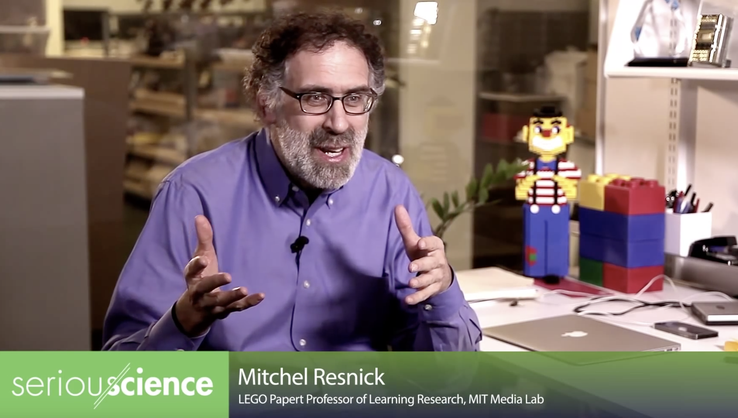
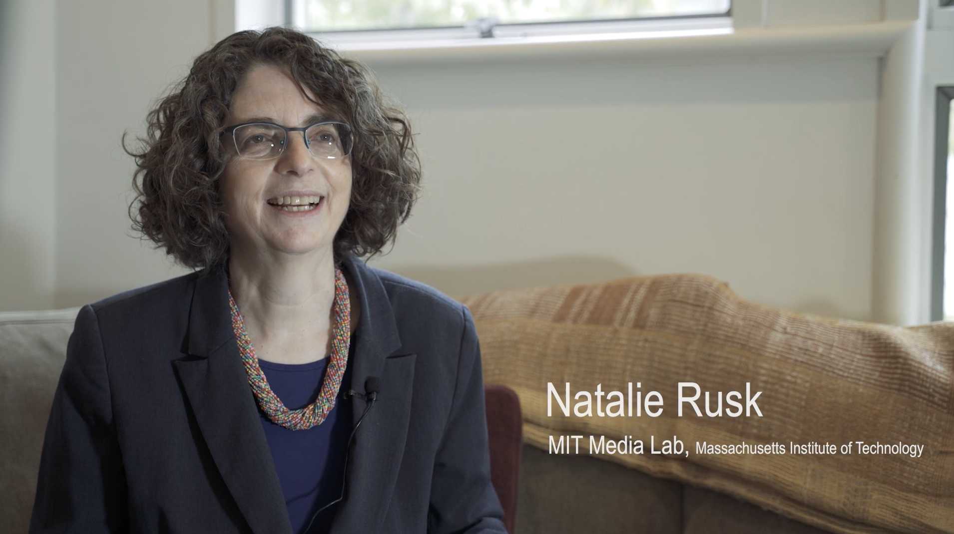
Computational Literacy/Fluency
Two videos from the Lifelong Kindergarten group @ MIT Media Lab
Coding is a new way for people to share ideas with the world
– an extended form of writing.
Like we learn to write and write to learn, we must learn to code and code to learn
Notes:
People in our community pinpoints this analogy to written language.
Mitch Resnick, for example, sees coding as a new way for people to share ideas with the world – an extended form of writing.
As Resnick says: Like we learn to write and write to learn, we must learn to code and code to learn.

Slide 12
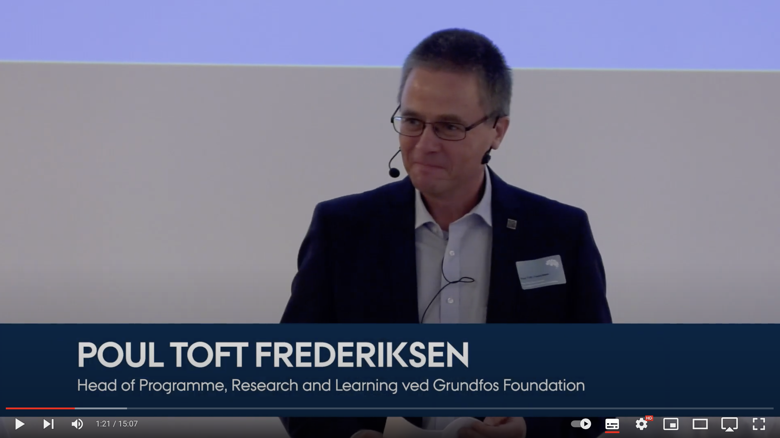
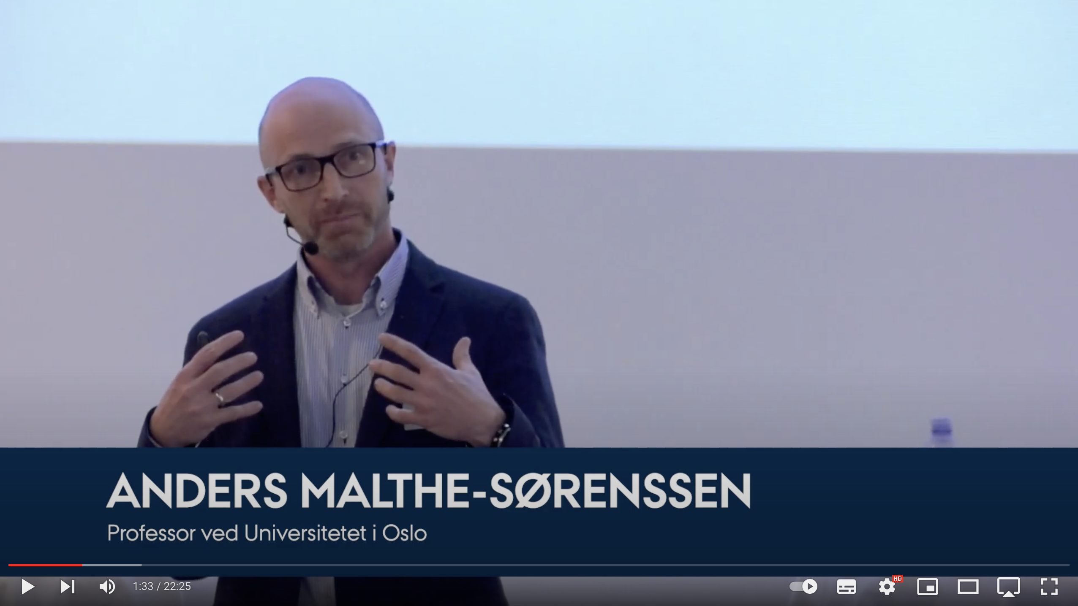
To anbefalelsesværdige præsentationer
Computational literacy
as a driver for disciplinary renewal
Revolution in the head
– the long-term perspectives of
informatics
Our success as a species rests not on our running speed, thick hide or acute sense of smell, but on our ability to communicate. We communicate through symbols – you did not drag a lion to the campfire to present the concept of ‘lion’. We seem to have an unbounded ability to invent new systems of symbols. They could be called languages or more precisely (and boringly) modes of expression.
In this talk I will argue that IT opens the door to a profoundly new mode of expression. The novelty of what we here call computational thinking is on par with writing and mathematics. Through anecdotal evidence from previous revolutions, I try to sketch the enormity of the revolution facing us and end with a modest proposal to improve the chances of (net) success for our journey.
Computing – using computers to solve problems – is changing the practice of the natural sciences, humanities, and social sciences. However, most educational content does not yet reflect this change and the use of computing is currently sparsely integrated into educational curriculums. This poses an exciting opportunity to rethink the contents of our educations and to integrate the use of computing as a natural component in the various disciplinary subjects. This opens for teaching students computational literacy and allowing them to develop computing as a natural part of their professional skill-set and identity.
We provide examples of how the integration of computing into science education programs has changed both the content and the form of the education. We will focus on how it provides students with opportunities to pursue realistic problems through authentic workflows, to participate in research early in their education, and to develop computational literacy through computational essays. We provide examples of how similar principles can be integrated in social science, such as economics, and the humanities.
Notes:
Magtperspektivet på sprog generelt og informatikkens sprog i særdeleshed udforskes i denne humoristiske og indsigtsfulde præsentation af Poul Toft Frederiksen. En varm anbefaling!
[Animation 1]
Informatikken ændrer praksisformerne ved forskning og uddannelse på universiteterne.
I denne præsentation giver Anders Malthe-Sørenssen eksempler på, hvordan integration af informatik i en række studieprogrammer inden for naturvidenskab, samfundsvidenskab og humaniora har ændret både indhold og form af uddannelserne.

Slide 13
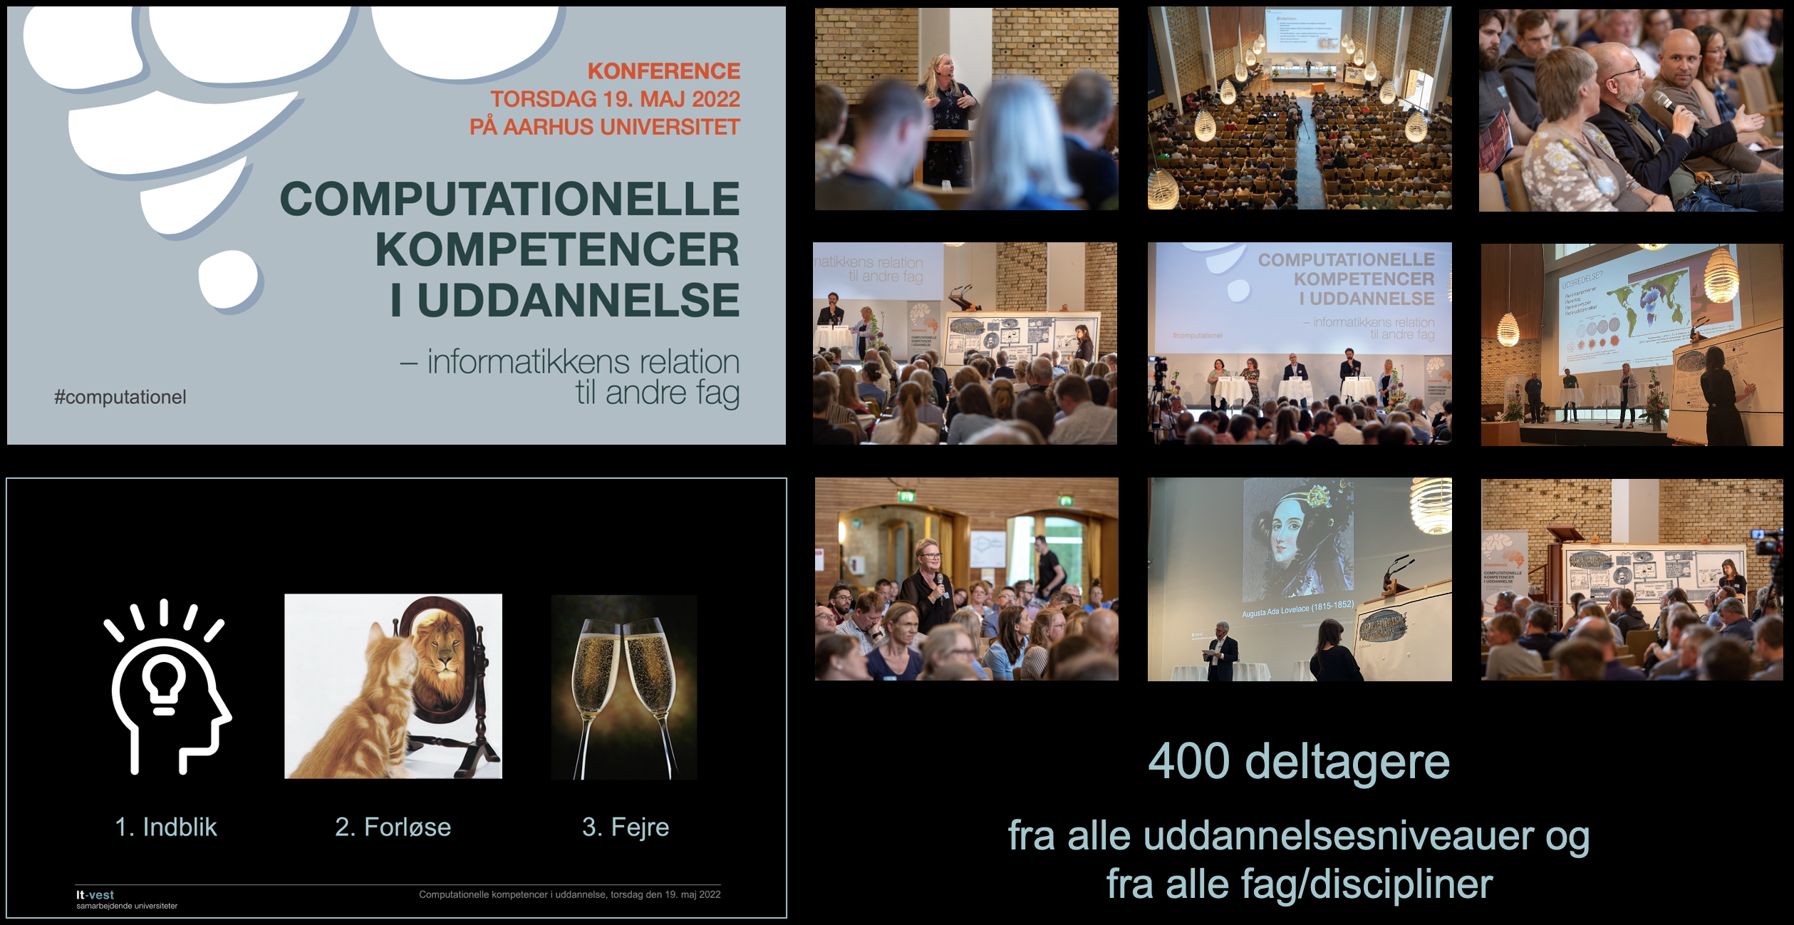
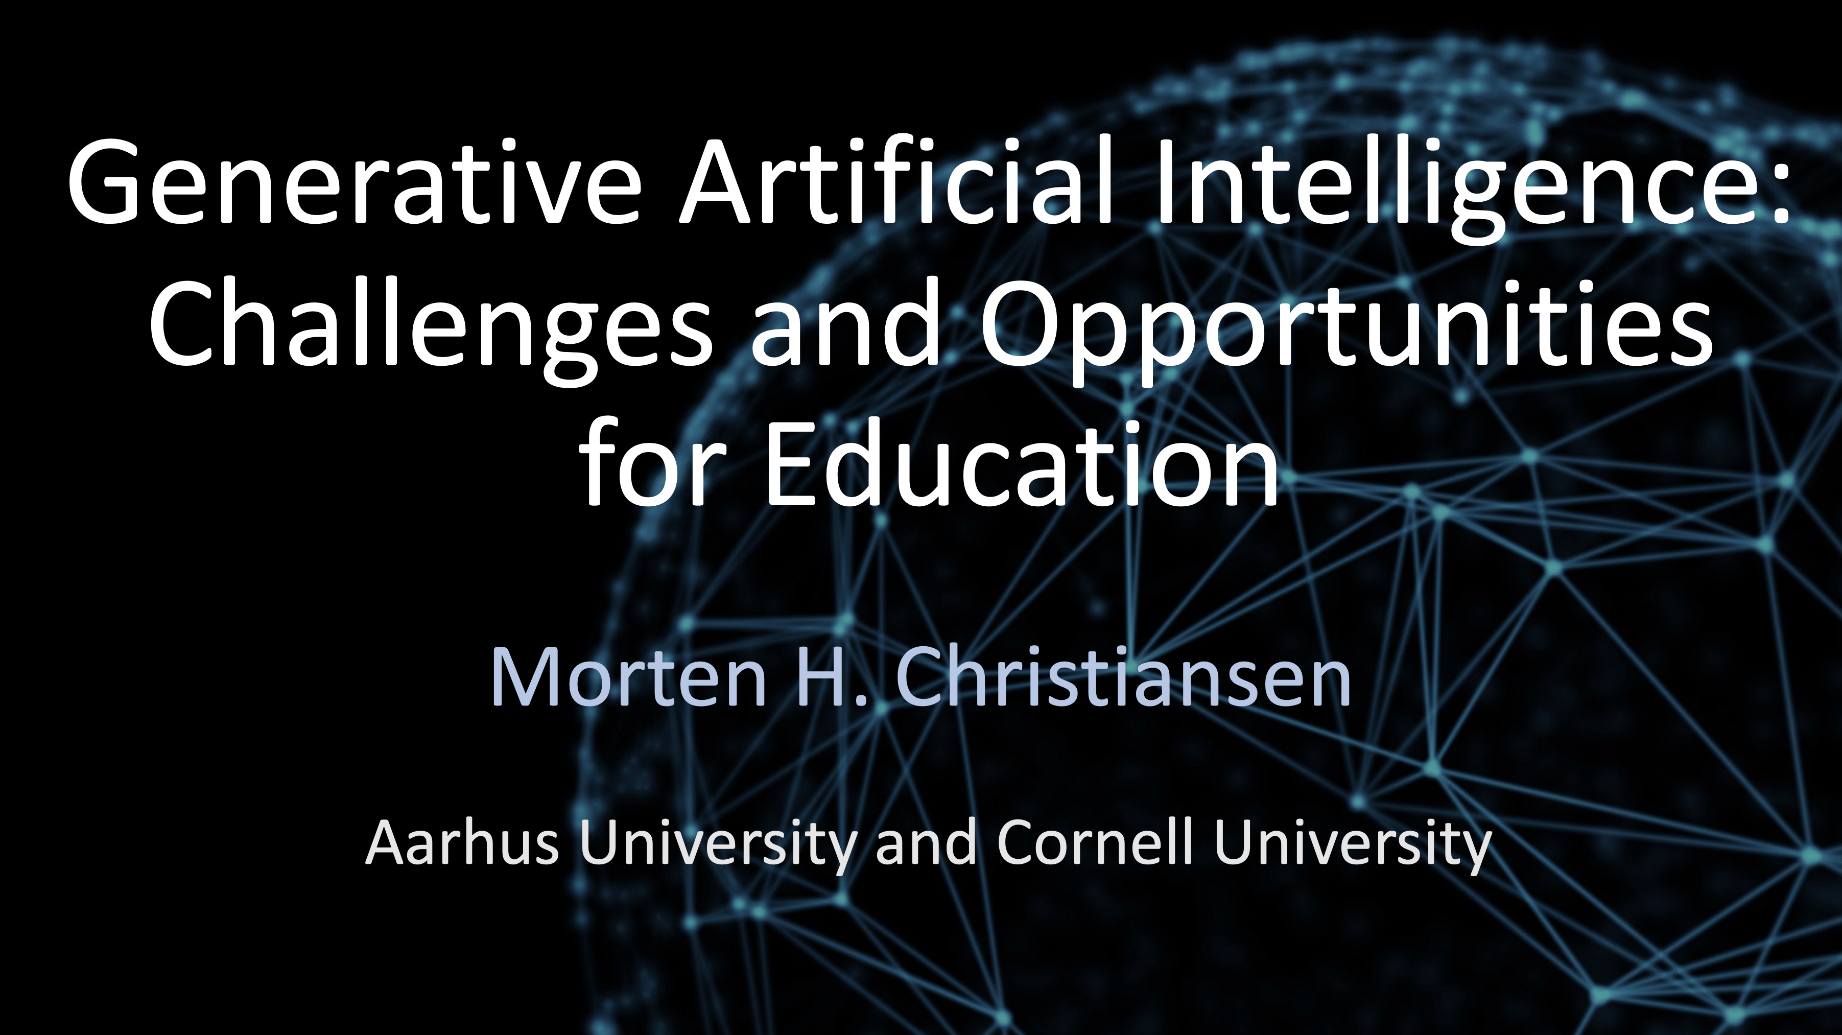
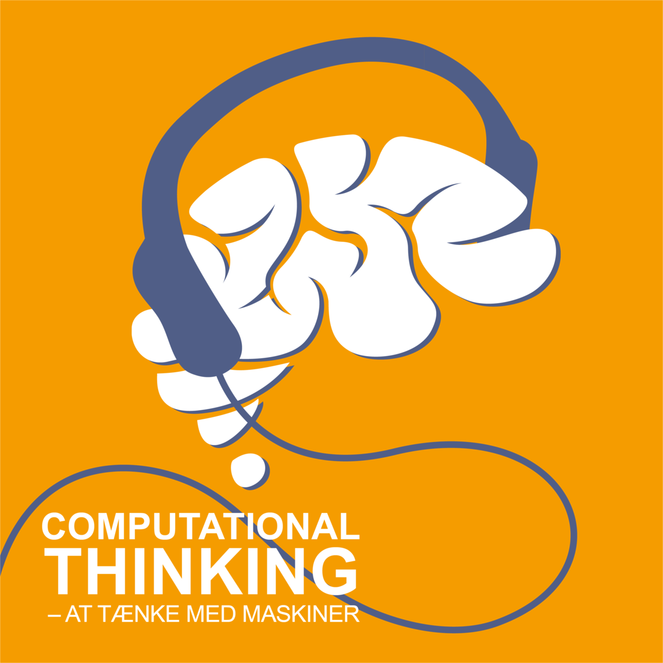
Digitale kompetencer i alle uddannelser
Vidensspredning
De seneste år har It-vest organiseret en lang række
konferencer og webinarer samt podcastserien
Computational thinking – at tænke med maskiner

Slide 14

Computational thinking – at tænke med maskiner
er en podcast-serie fra It-vest om informatik og brugen af computationelle metoder i forskning og uddannelse.
I podcast-serien undersøger vi, hvordan såkaldte computationelle metoder kan spille en rolle i forskning, fra fysik over antropologi til litteraturvidenskab.
Den primære målgruppe for podcast-serien er gymnasielærere og -elever, men serien er i øvrigt relevant for alle med interesse for den digitale udvikling i samfundet og specielt inden for uddannelse og forskning i alle fag.
Der er indtil videre 34 episoder, men flere er på vej. Lyt med og bliv overrasket, informeret og nysgerrig på mere...

Slide 15
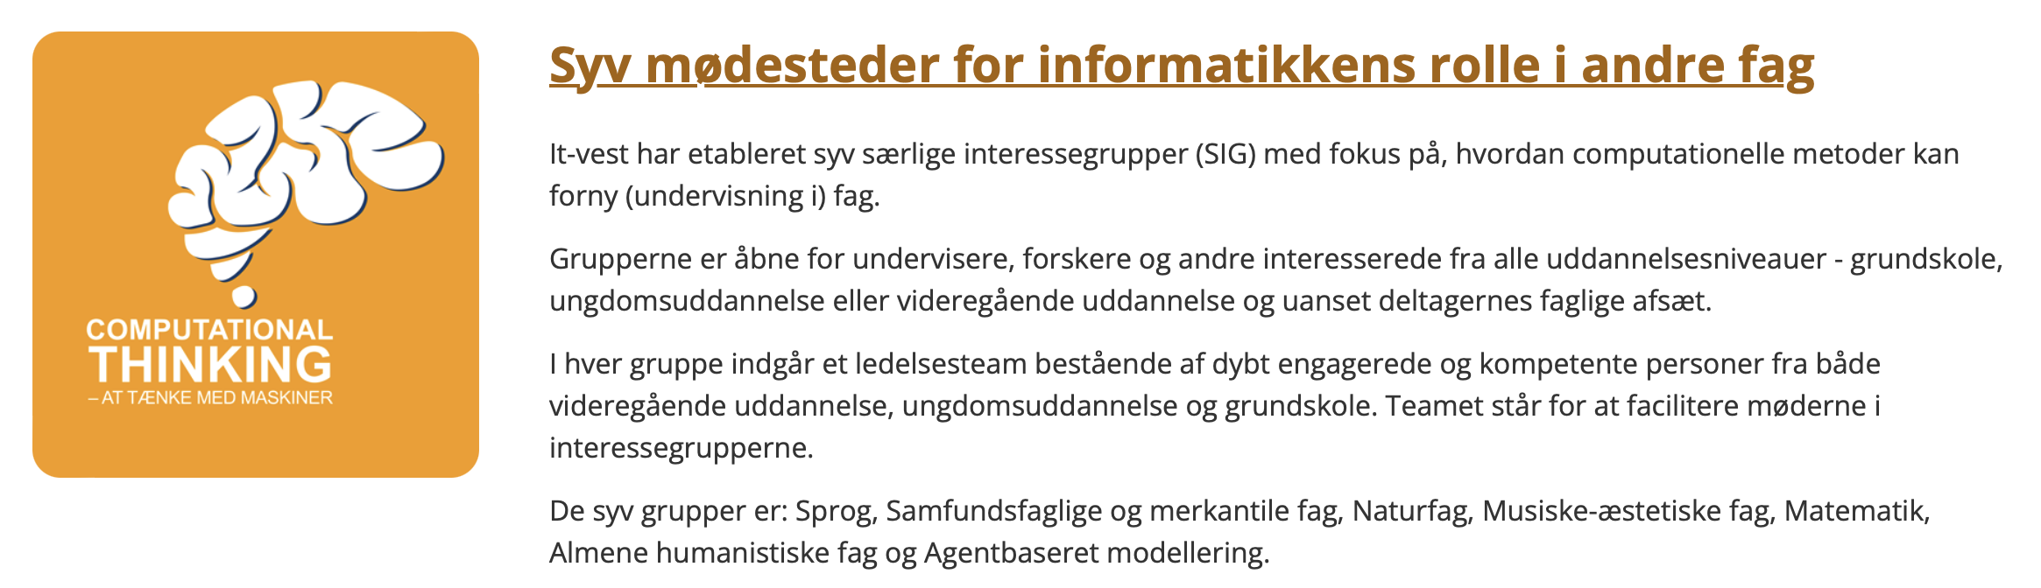
Digitale kompetencer i alle uddannelser
Netværksdannelse

